Slide 1
OOP 2,
Design Patterns, DataStructures, Client Architecture Patterns

Slide 2
OOP 2
Super Class
Abstract Classes
Interfaces
Polymorphism

Slide 3
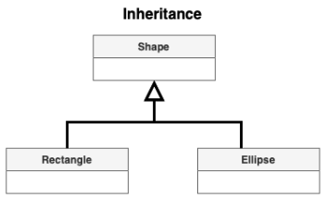
Super Class / Base Class
A superclass (also known as a base class or parent class) is a class from which other classes derive.
Classes that derive from a superclass are called subclasses (or child classes).
This mechanism is called inheritance and allows a child class to inherit attributes and methods from a parent class.

Slide 4
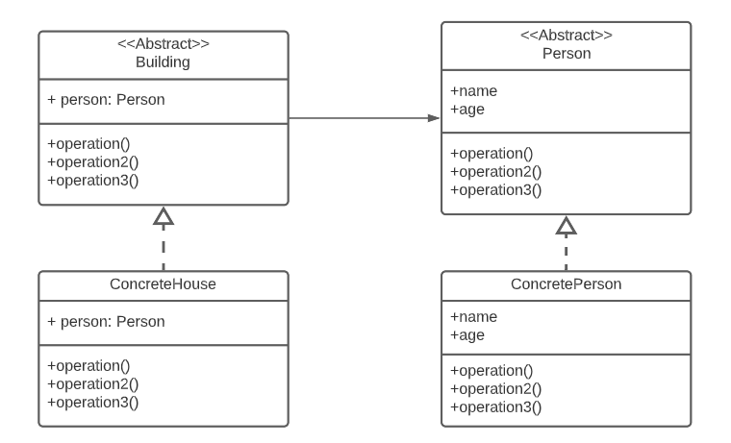
Abstract Classes
It cannot be instantiated directly.
It is a class that contains at least one abstract method.
Subclasses of an Abstract class are FORCED to implement the inherited abstract methods, or redefine them as abstract, delegating the implementation to lower classes.

Slide 5
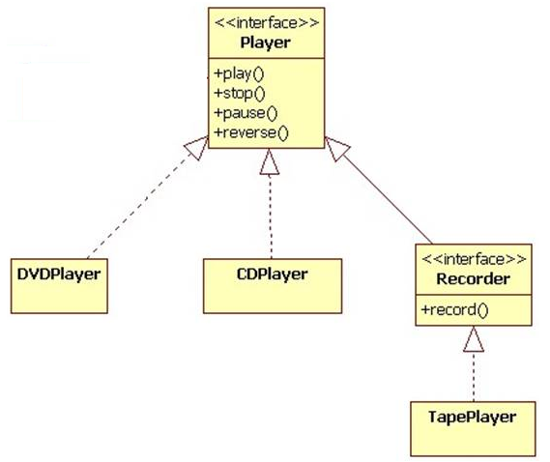
Interfaces
An interface is a contract between 2 classes that defines methods and properties without implementation.
Classes that implement it must provide their own implementation.
Except when inherited by another interface or implemented by an abstract class, implementation can be delegated.

Slide 6
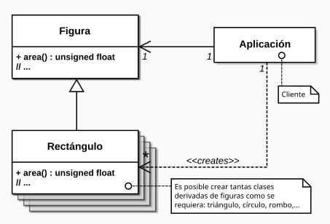
Polymorphism
Polymorphism allows the same method to be executed in different ways depending on the type of object.
The interesting thing is that, using the same function on all the figures, you get the area without having to know what type they are.

Slide 7
Design Patterns
Creational
Structural
Behavioral

Slide 8
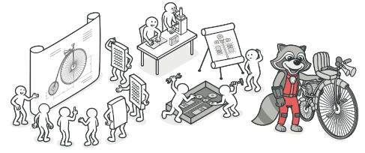
Design Patterns
Design patterns are typical solutions to common problems in software design.
Each pattern is like a blueprint that you can customize to solve a particular design problem in your code.
They are divided into 3 main group of patterns: Creational, Structural and Behavioral.

Slide 9
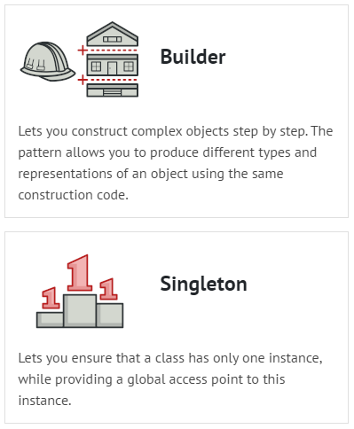
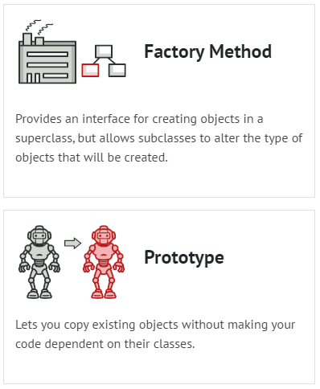
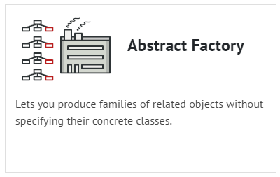
Creational Design Patterns
They abstract the process of creating objects.
It helps us separate how an object behaves from how we have to build it.

Slide 10
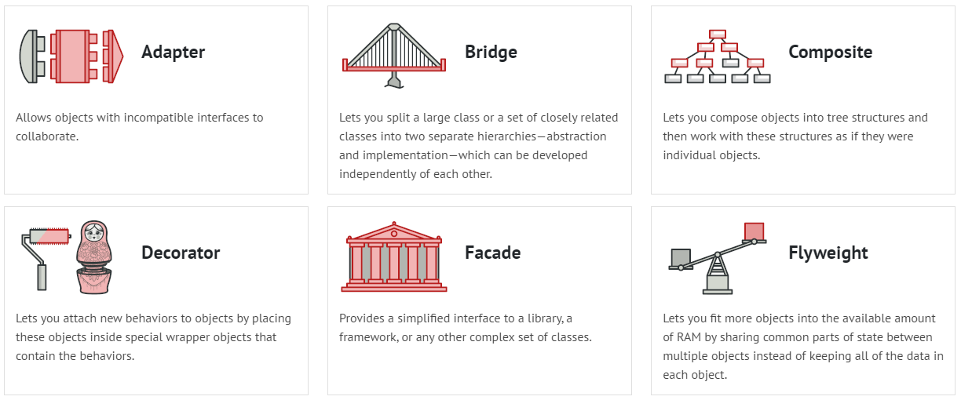
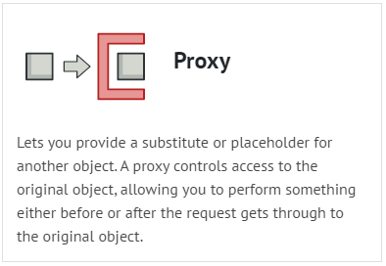
Structural Design Patterns
They explain how to assemble objects and classes into larger structures, keeping these structures flexible and efficient.

Slide 11
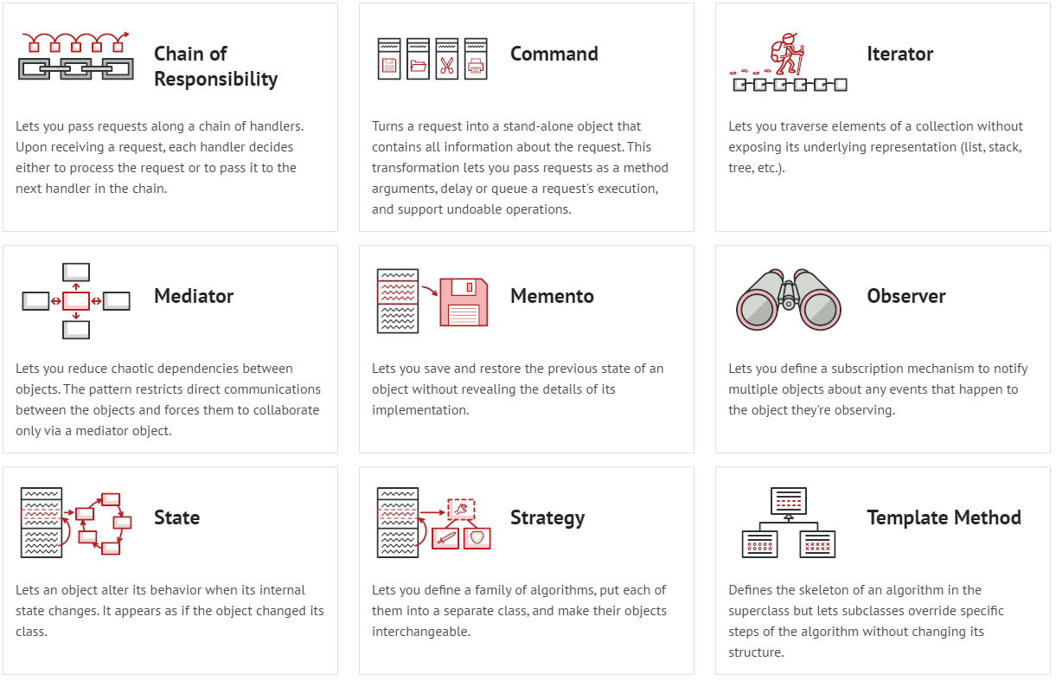
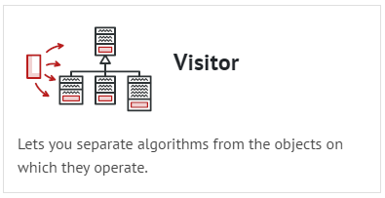
Behavioral Design Patterns
Behavioral design patterns are concerned with algorithms and the assignment of responsibilities between objects.

Slide 12
Data Structures
Generics
Arrays
Lists
Queues
Stacks
KeyValuePair
Dictionaries
HashSets

Slide 13
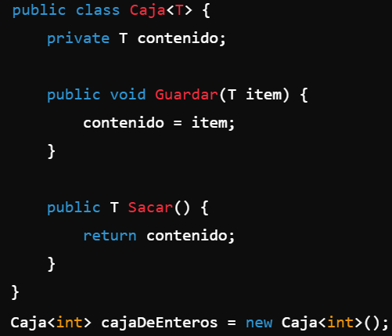
Generics
They allow you to create classes, methods, interfaces, and structures that can work with any type of data.
Code reuse and easier to maintain
Data collections like Lists use Generics: List<T>

Slide 14

Arrays (T[])
Fixed-size structures that store elements of the same type.
When you know the size of the data in advance and don't need to change it, making arrays efficient in memory and access.

Slide 15
Lists (List<T>)
Dynamic collection that can grow or shrink.
Ideal for item lists whose size changes frequently during gameplay, such as enemy management or temporary item collections.

Slide 16
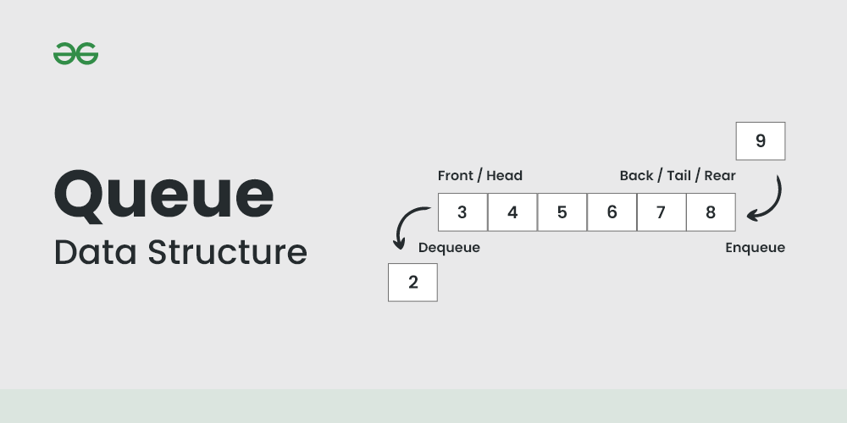
Queues (Queue<T>)
FIFO (first in, first out) structure.
Perfect for sequences of events or tasks where order is important, such as a queue of actions in an AI or command queue.

Slide 17
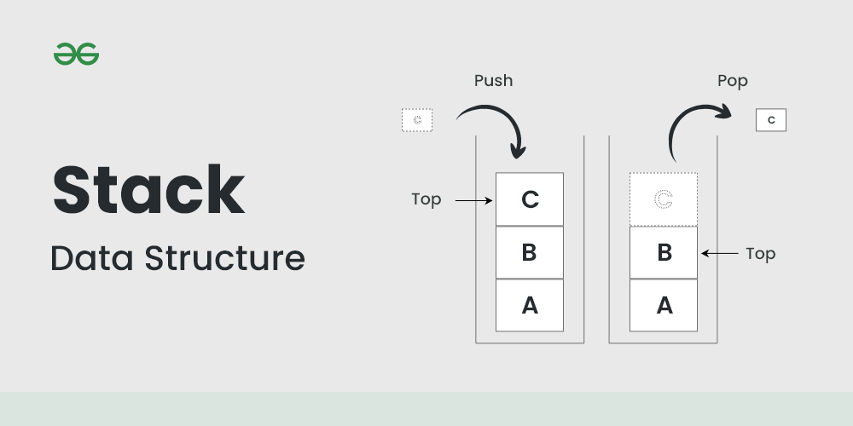
Stacks (Stack<T>)
LIFO (last in, first out) structure.
Ideal for undo/redo systems or for tracking temporary states, such as a menu navigation system where you need to go back.

Slide 18
KeyValuePair (KeyValuePair<TKey, TValue>)
Represents a related pair of values ​​(key-value).
Useful for returning related data pairs from functions or for temporarily matching two values ​​without using a full dictionary.

Slide 19
Dictionaries (Dictionary<TKey, TValue>)
Collection of unique key-value pairs.
Ideal for quick lookups when you need to access data via a key, such as an inventory of objects or assigning prefabs to their names.

Slide 20
HashSets (HashSet<T>)
Collection of unique items in no specific order.
Perfect when you need to ensure there are no duplicates, such as in the list of items collected by the player or to avoid repeated actions.
It is highly efficient for search, insert and delete operations.

Slide 21
Client Architecture Patterns
MVC
MVC: Real Example
Other Patterns

Slide 22
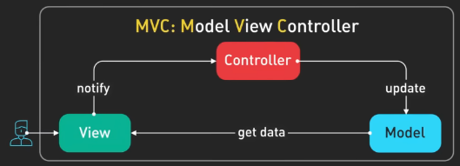
Client Architecture Patterns: MVC
Model:
This represents the data and business logic of the application.
Doesn’t worry about how the data is shown to the user, just about managing and updating it.
View:
This is what the user interacts with (UI).
Focused on the presentation, not the logic.
Controller:
The controller connects the Model and the View.
It receives input from the View (such as a button click), processes it (like deciding what the app should do), and then updates the Model or tells the View to change.

Slide 23
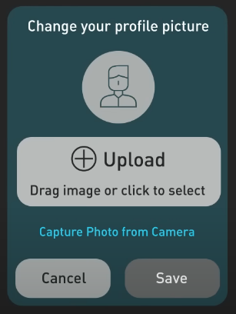
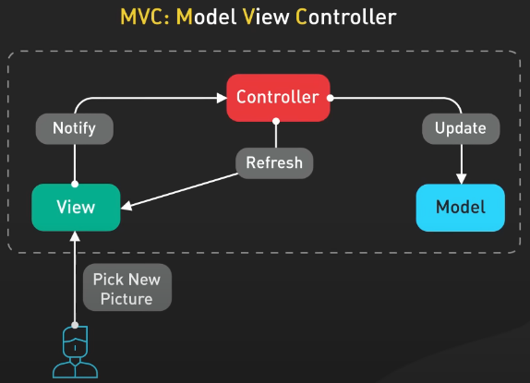
Client Architecture Patterns: MVC - Real Example
User trying to update their profile picture.
When the user picks a new picture, the view sends this action to the Controller, which then updates the Model.
Once the model is updated, the Controller tells the View to refresh the Display.
This pattern can lead to Bloated Controllers if the app grows

Slide 24
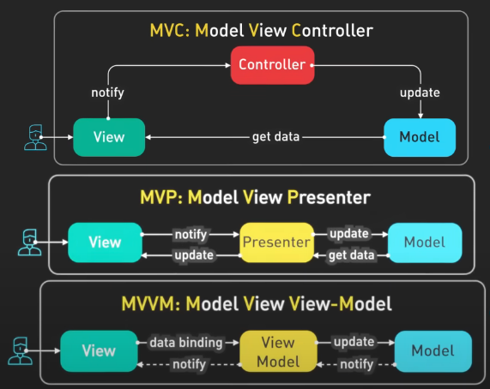
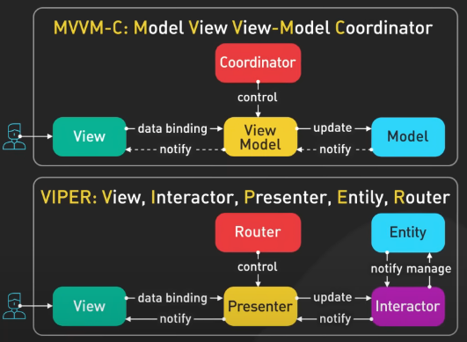
Client Architecture Patterns: Other Patterns

